Slide 1
Online Machine Learning Algorithms for Currency Exchange Prediction
Eleftherios Soulas & Dennis Shasha
Presented by: Jason Arrabito

Slide 2
Average Data Generated

Slide 3
"Fourth Paradigm” of Science
Experiments at the LHC (Large Hadron Collider) produce 30 Petabytes - 30 million Gigabytes - of data every year, which has to be stored, backed up, and made available to more than 8,500 scientists around the globe.
In mission operations for NASA"s MISR Satellite, spatial samples are acquired every 275 meters. Over a period of 7 minutes, a 360 km wide swath of Earth comes into view from cameras pointed in 9 dierent directions.Terabyte data are generated every day.
In telecommunications, the AT&T long distance data stream consists of approximately 300 million records per day from 100 million customers.
“One of the greatest challenges for 21st-century science is how we respond to this new era of data-intensive science. This is recognized as a new paradigm beyond experimental and theoretical research and computer simulations of natural phenomena—one that requires new tools, techniques, and ways of working.”
— Douglas Kell, University of Manchester

Slide 4
Purpose
Our intent is to build a foundational library of primitives to perform online or near online multi-stream information extraction on thousands or even millions of time series. Besides their immediate use, such primitives could provide a first level analysis of time series for online clustering and data mining systems.

Slide 5
Streaming Frameworks
In many real life applications the data set under process is not a constant source of input, but rather a vast stream of continuously updated data.
Often those data arrive at random rates and in no specific order.
An example of such an application might be the continuous updates in large social networks and varied appliances found in finance, telecommunications, physics, biology, astronomy, etc.
Consequently there has been a pronounced interest in streaming databases that can handle queries on such type of data.

Slide 6
STATSTREAM
Sliding windows (sw) begin at the multiples of another entity called basic window (bw).
An algorithm is used to find all highly correlated pairs in a sliding window, assuming that the data inside that window can be well modeled by its first few Fourier coefficients
The Fourier Series breaks down a periodic function into the sum of sinusoidal functions (sine & cosine)
Statstream is responsible for finding all the stream pairs, with correlation above a threshold provided by the user, inside a sliding window.
Notes:
More formally, it decomposes any periodic function or periodic signal into the sum of a (possibly infinite) set of simple oscillating functions, namely sines and cosines (or, equivalently, complex exponentials).

Slide 7
Discrete Fourier Transform (DFT)
Identifies component frequencies in data
DFT is used as a means of reducing the dimension of data.
First few coefficients of DFT transformation are used to compute the distance between time series.
Those time series pairs whose distance in coefficient space is smaller than a certain threshold are picked out for the second-stage verification.
The above operations are performed within each sliding window and the framework can be used for both synchronous and asynchronous correlation discovery.

Slide 8
Sketch Based Statstream
Extension of DFT based Statstream
High Dimensional Data Points are reduced to Low Dimensional Data Points while preserving the norm within a factor. This is done using Statstream.
During the process Statstream computes a synopsis vector for each time series
The synopsis vector is used to filter out uncorrelated time series pairs
After synopsis filtering the correlation will be verified using the full time series against the surviving correlated pairs.

Slide 9
The Goal of Statstream
Synchronous Correlation: Given N_{s} streams, a start time t_{start,} and a window size w, for each window, W, of size w, all pairs of streams S1 & S2 such that S1 during time window W is highly correlated with S2 during the same window.
Asynchronous Correlation: Allows shifts in time. Given N_{s} streams in windows size w, find all the windows W1 & W2 where |W1| = |W2|= w and all pairs of streams S1 & S2 such that S1 during W1 is highly correlated with S2 during W2. Therefore a correlation of pairs in stream(s) over a moving window.
“To find correlation over windows from the same or different streams on synchronous and asynchronous (lagged) variations”
Notes:
Correlation typically over 95%

Slide 10
Time Series: Cooperative vs. Uncooperative
For our problem (this paper) we are interested in calculating all the pairwise correlations of N_{s} streams (one or more) in a sliding window of size sw
Cooperative: The time series exhibits a substantial degree of regularity
There are several data reduction techniques that can be used in order to compresslong time series in few coecients, such as Fourier Transform Methods
Uncooperative: Time series with no such periodical regularities
An example can be the returns of a stock quote as the increase or decrease between two consecutivetime-points do not necessarily follow any certain patterns.

Slide 11
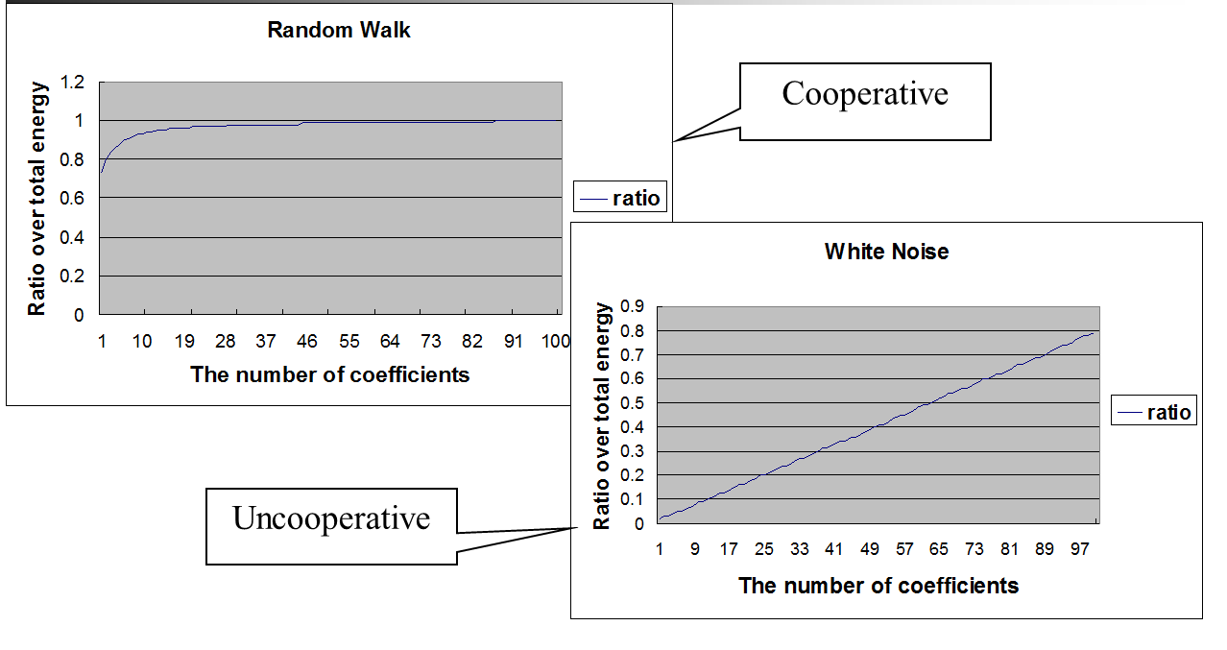
Cooperative vs. Uncooperative

Slide 12
Sketch Based Statstream for Financial Data
Unfortunately, many applications generate uncooperative time series.
Many of these series consist of excessive “white noise”.
For collections of time series that do not concentrate power in the first few Fourier/Wavelet coefficients, which we term uncooperative, we use the sketch based version of Statstream 2.0.

Slide 13
Sketch Based Statstream FEATURES
Time-point: The smallest unit of time over which the system collects data, for example a second s
Basic window: A consecutive subsequence of timepoints over which the system maintains a compressed representation, for example two minutes
Sliding Window: A user-defined consecutive subsequence of basic windows over which the user wants statistics, for example an hour. This way the user can submit queries for highly correlated stream pairs which were above a certain threshold for the past sliding window, for example an hour.

Slide 14
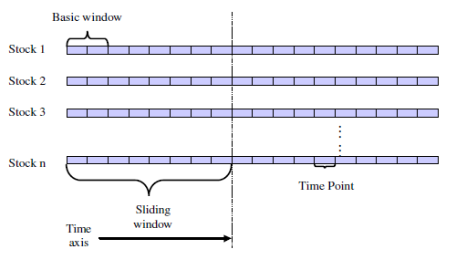
Time Perception in Statstream
The choice of sw and bw depends on the application under consideration, because bw is the delay before results are reported. For instance, a trader may ask which pairs of stock returns have been correlated witha value of over 0.9 for the last three hours and want the correlation information reported every 30 seconds.

Slide 15
Sketch Implementation in Statstream
R_{bw} is constructed as follows:
r_{bw} = (r₀, r₁, … r_{bw})
where
{r_{i}} = {+1, with probability ½
{+1, with probability ½
To form a random vector of length sw, another random vector b is constructed of length nb = sw/bw
b = (b₀, b₁, … b_{nb})
{b_{i}} = {+1, with probability ½
{+1, with probability ½
The idea presented is to form a random vector r from the concatenation of nb = sw/bw random vectors r = s₁, s₂, … s_{nb} where each s_{i} has length equal to bw. Each s_{i} is either a u of –u and u is a random vecor in {-1,1}^{bw}

Slide 16
Sketch Implementation in Statstream
The random vector r for a sliding window is then built as follows:
r = (r_{bw} * b₀ , r_{bw} * b₁, … , r_{bw} * b_{nb})

Slide 17
Sketch Implementation in Statstream
We will show an example of the sketches for the follwing two streams of size sw = 12
X¹_{sw} = (x₁, x₂, x₃, x₄, x₅, x₆, x₇, x₈, x₉, x₁₀, x₁₁, x₁₂)
X⁵_{sw} = (x₅, x₆, x₇, x₈, x₉, x₁₀, x₁₁, x₁₂, x₁₃, x₁₄, x₁₅, x₁₆)
Now let's assume we are given a time series X = (x_{1,} x₂,…), with a sliding window of size
sw = 12, and a basic window of size bw = 4.
If the random vector within a basic window is r_{bw} = (1, 1,-1,1), and the control vector
b = (1,-1,1), then the random vector for a sliding window will be
r_{sw} =
(1, 1, -1, 1, -1, -1, 1, -1, 1, 1, -1, 1)

Slide 18
Sketch Implementation in Statstream
X¹_{sk} = r_{sw} * X¹_{sw}
= b₁ * r_{bw} * (x₁, x₂, x₃, x₄) + b₂ * r_{bw} * (x₅, x₆, x₇, x₈) + b₃
* r_{bw} * (x₉, x₁₀, x₁₁, x₁₂)
= b * (r_{bw} * (x₁, x₂, x₃, x₄), r_{bw} * (x₅, x₆, x₇, x₈), r_{bw}
* (x₉, x₁₀, x₁₁, x₁₂))
X⁵_{sk} = r_{sw} * X⁵_{sw}
= b₁ * r_{bw} * (x₅, x₆, x₇, x₈) + b₂ * r_{bw} * (x₉, x₁₀, x₁₁, x₁₂) + b₃
* r_{bw} * (x₁₃, x₁₄, x₁₅, x₁₆)
= b * (r_{bw} * (x₅, x₆, x₇, x₈), r_{bw} * (x₉, x₁₀, x₁₁, x₁₂), r_{bw}
* (x₁₃, x₁₄, x₁₅, x₁₆))

Slide 19
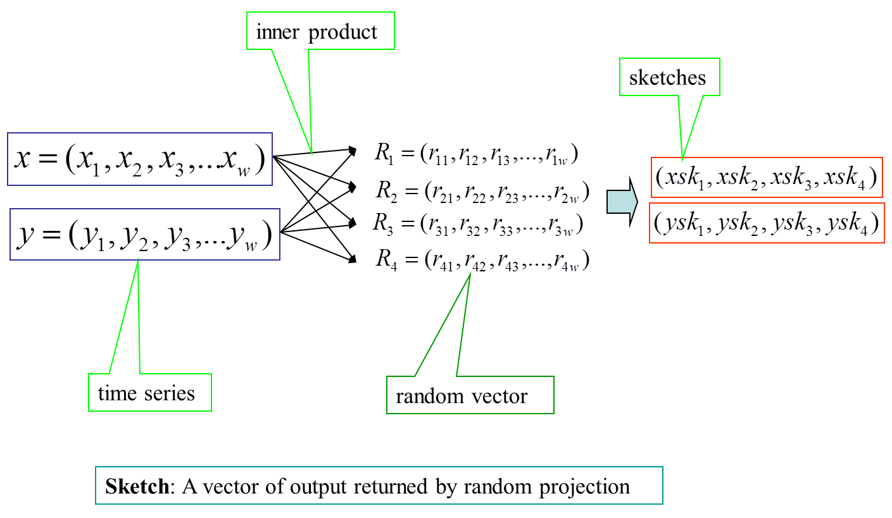
Sketch Vector Partitioning Visual

Slide 20
Sketch Implementation in Statstream
To determine the closeness of the vectors we partition each sketch vector into sub vectors and build data structures for the sub vectors.
Given the idea of partitioning sketch vectors, the problem comes down to how we can combine the results of the different partitions.
For example, if each sketch vector is of length 40, we might partition each into ten groups of size four. Consequently, this would yield ten data structures. Then the adjacent results of pairs, are combined from each data structure to determine an overall set of candidate correlated windows.
We use correlation and distance more or less interchangeably because one can be computed from the other once the data has been normalized. Specically, Pearson correlation is related to Euclidean distance as follows:
D² (ŵ, ŷ) = 2(1 – corr(w, y))

Slide 21
Sketch Implementation in Statstream
Partition each sketch vector s of size N into groups of some size g.
The i_{th} group of each sketch vector s is placed in the i_{th} grid structure of dimension g.
If two sketch vectors s₁ and s₂ are within distance c * d¹ in more than a fraction f of the groups, then the corresponding windows are candidate-highly-correlated windows and will accordingly be checked exactly.

Slide 22
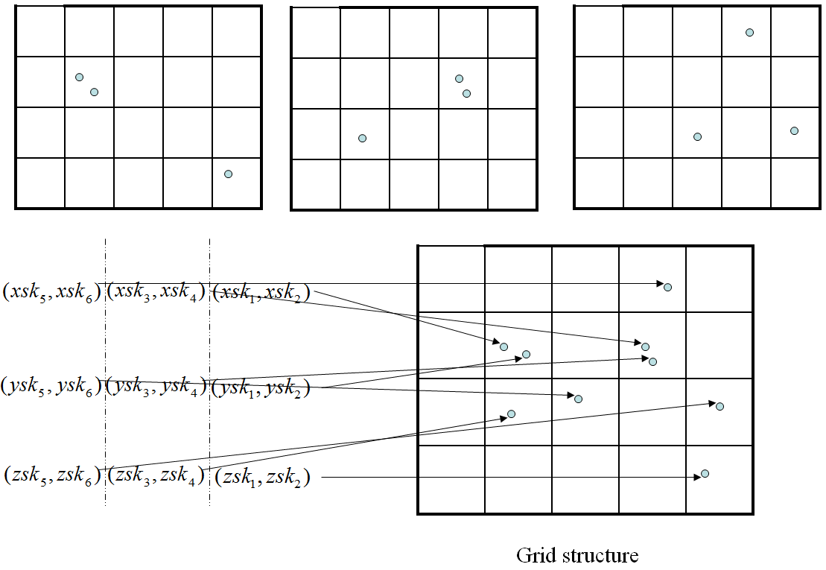
Sketch Implementation in Statstream

Slide 23
Statsream Renewed
The authors of the paper translated the Statstream software from the language K to Python to increase popularity because Python has a larger more developed community.
In addition to a programming language change they also did some minor debugging for things such as:
Normalization Code
Division by Zero
Statstream was also given a graphical interface “makeover”

Slide 24
Online Machine Learning
We conclude our analysis by simulating a simplistic model of a trading environment. The trading strategy we follow is the most basic we could think of, meaning that the predictions based on our new algorithm manage to deliver substantial profits even if the trading part of the algorithm is not necessarily the most sophisticated.
For the most part we based our analyses on Forex data but we also experimented with more than nancial datasets.

Slide 25
Machine Learning in Finance
ML themes include reinforcement learning, optimization methods, recurrent and state space models, on-line algorithms, evolutionary computing, kernel methods, Bayesian estimation, wavelets, neural nets, SVMs, boosting, and multi-agent simulation.
Machine learning (ML) and related methods have produced some of the financial industry’s most consistently profitable proprietary trading strategies during the past 20 years.
Financial topics include high frequency data, trading strategies, execution models, forecasting, volatility, extreme events, credit risk, portfolio management, yield curve estimation, option pricing, and selection of indicators, models, and equilibria.

Slide 26
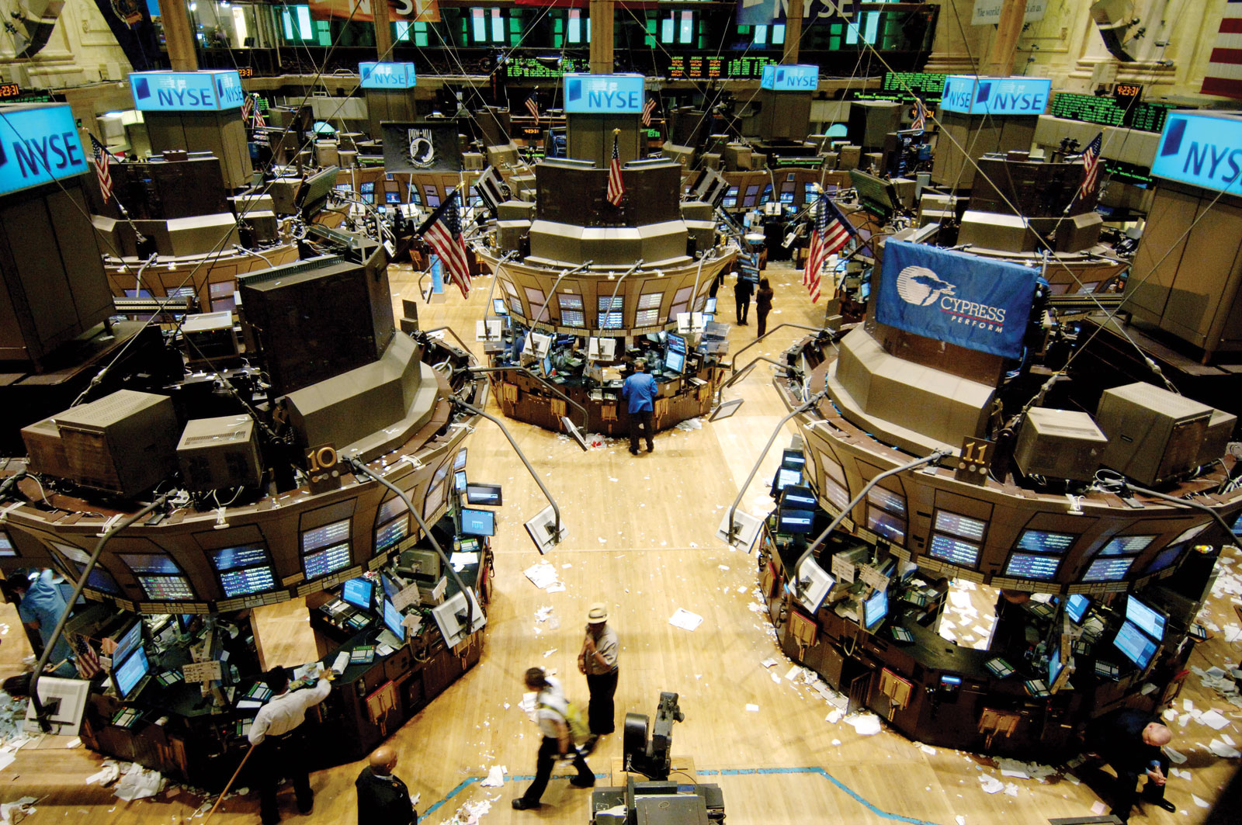
Investment Option Background
STOCKS
The stock can be bought in the primary or secondary market. When the company issues the stock for the first time, also called public issue, anyone can subscribe to this issue. There may be some restrictions regarding the number, the mode of payment and place where the applications can be submitted.
The other market is the secondary market. Huge transactions take place in this market every working day. Here the existing shareholders sell their shares to buyers.

Slide 27
Investment Option Background
BONDS
A bond is defined as a long-term promissory note with stipulated interest supported by a consideration or under seal secured by a mortgage. Bonds hold the promise of stipulated interest on a long-term basis. There is a guarantee for the performance. Those issued by the Governments are also termed securities. The issuing Government or Federal Government, in the case of issue by State Government or Local Authority, guarantees the payment.

Slide 28
Investment Option Background
MUTUAL FUNDS
Consider an individual investor who wishes to invest in stock but has limited money. On the other hand, the different stocks being traded in the stock market are quite large. When an opportunity arises to purchase some stock, he may not have the liquidity necessary capital. He may not be able to study the trends in stock market. He may not be able to analyse the movement of prices in the stock market. In short very few persons can have the time, knowledge and skills to take the best advantage of opportunities that arise in the stock market.

Slide 29
Investment Option Background
Mutual funds are basically investment companies, which continuously sell and buy stock. Anyone can participate in its activities by investing in the mutual fund. The investment company, usually a trust, manages the total capital available to a mutual fund.
Notes:
Mutual funds state specic investment objectives in their prospectus. The main type or objectives are growth, balanced income, and industry specic funds.
Growth funds possess diversied portfolios of common stocks in the hope a portfolio of stocks, and bonds.
Income funds concentrate heavily on high interest and high dividend yielding securities.

Slide 30
Investment Option Background
FOREX
This investment option is of most importance as it was the central focus of this project.
Simply:
Each country has its own currency. Whenever one currency is exchanged with another it is a foreign exchange or Forex transaction.

Slide 31
Investment Option Background: FOREX
Foreign exchange rates were tied to the amount of gold reserves belonging to the nation. However, in the summer of 1971, President Nixon took the United States off the gold standard. After this many countries followed and there was no relation between the gold reserves and the exchange rates. Floating exchange rates came into existence.
Increasing trade and foreign investment have made the economies of all nations more and more interrelated. Economic figures are regularly reported around the world. Inflation, unemployment levels, unexpected news, such as natural disasters or political instability, alters the desirability of holding a particular currency. This influences the international supply and demand for that currency.

Slide 32
Investment Option Background: FOREX
Forex investments are essentially trading in the future via options. An option gives you the right, but not an obligation, to buy or sell a specific amount or foreign exchange at a specified price within a specified period. Options are termed either call or put. A call gives the holder the right to buy the foreign currency or Forex at a specified price. The put gives the right to sell Forex at a specified price. Depending on the actual market price when you exercise the option you will gain/lose the difference between the specified price and the market price.
The gain an investor makes will depend on the actual difference in the market price and the options price. However, there will be some fee/commission levied. This would be the cost of transaction, and result in a reduction of the gain, to some extent.

Slide 33
Investment Option Background: FOREX
The foreign exchange market is the largest financial market in the world. Traditionally the foreign exchange market has only been available to banks, money managers and large financial institutions.
Today the foreign exchange market offers opportunities for profit not only to banks and institutions, but also to individual investors. More accurately it can be noted that large markets involve trading of $1,500 billion every day.
Forex trading presents many computational challenges that may be applicable for state of the art computer science techniques.

Slide 34
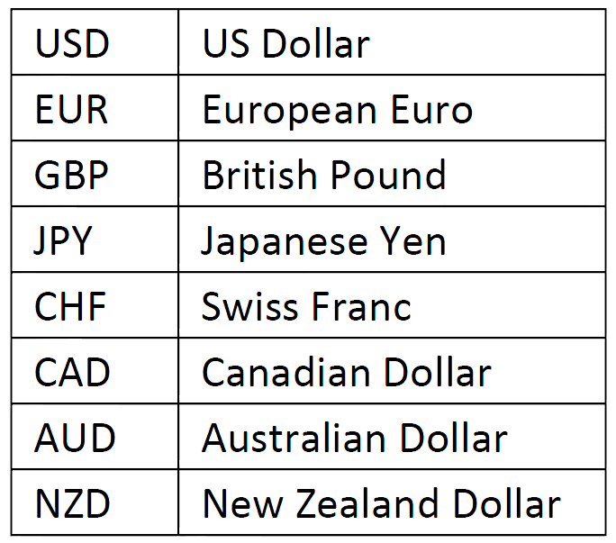
FOREX
The 8 most traded currencies of the FOREX Market
The forex market has bid and ask prices that are constantly changing. Investors trade foreign currency units that can be as small as a thousand units or as large as a billion units.
The bid price is the price at which the dealer rm would be willing to buy the foreign currency units.

Slide 35
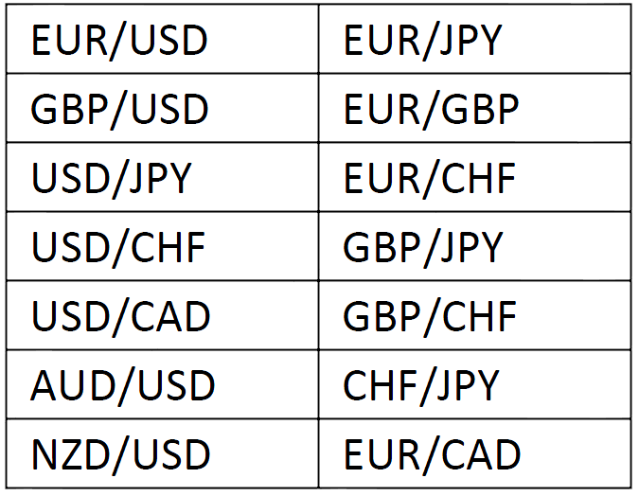
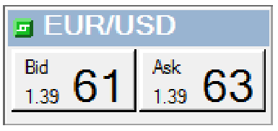
FOREX
The bid price is the price at which the dealer rm would be willing to buy the foreign currency units.
This will always be lower than the quote price.
The ask price, also known as the offer price, is the price at which the dealer firm would willing to sell the foreign currency units.
This will always be greater than the quote price.
The bid-ask spread is the width of the buying and selling prices. If the market is in a so-called fast market, the prices will fluctuate in a way that will make the bid and ask spread widen on the side of the asking price or on the side of the bid price.

Slide 36
Supervised and Unsupervised Machine Learning
There are two discernible categories of machine learning: supervised and unsupervised learning.
In Supervised Learning, the system receives a dataset as an input and uses it to make decisions and classifications.
Unsupervised Learning is a pure learning process where the system must classify and make decisions based only on the sequence of its past actions via trial and error.
For this project we were mainly interested in supervised learning and especically gradient descent type of algorithms which are proved to be adequate for many machine learning applications.

Slide 37
Gradient Descent There are two main types:
Batch Algorithms
Online Algorithms
Completely optimize the cost functions on a set of training examples (eg ARIMA models).
“As datasets grow to practically infinite sizes, we argue that online algorithms outperform learning algorithms that operate by repetitively sweeping over a training set.”
Operate by repetitively drawing a fresh random example and adjusting parameters on the basis of this single example only.
“Online algorithms can quickly process a large number of examples. On the other hand, they usually are not able to fully optimize the cost function defined on these examples.”

Slide 38
Batch Gradient Descent
In order to minimize empirical risk E_{n}(f_{w}) the use of gradient descent is proposed and each iteration of the algorithm updates the weights w on the basis of the gradient of E_{n}(f_{w})

Slide 39
Stochastic Gradient Descent
Stochastic gradient descent is of crucial importance to this project as it constitutes the cornerstone of our algorithm.
Stochastic Gradient Descent algorithm is a drastic simplification of the batch gradient descent. Instead of computing the gradient of E_{n}(f_{w}) exactly, each iteration estimates this gradient on the basis of a single randomly picked example.
This stochastic process depends on permutation (shuffling) of the training data before fitting the model.
Notes:
Averaging this update over all possible choices of the training examples would restore the batch gradient descent algorithm.

Slide 40
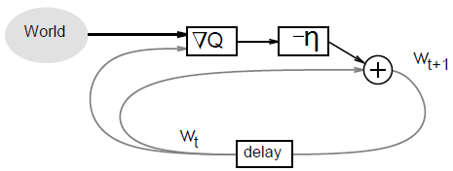
Stochastic Gradient Descent (SGD)
The online gradient descent simplification relies on the hope that the random noise introduced by this procedure will not perturbate (alter) the average behavior of the algorithm.
Since the stochastic algorithm does not need to remember which examples were visited during the previous iterations, it can process examples on the fly in a deployed system.
SGD is perfectly applicable to the streaming environment
The parameters of the learning system are updated using information extracted from real world observations.
Notes:
Averaging this update over all possible choices of the training examples would restore the batch gradient descent algorithm.

Slide 41
Stochastic Gradient Descent (SGD)
The python class we use implements a first-order SGD learning routine. The algorithm iterates over the training examples and for each example updates the model parameters according to the update rule given by:
Where η is the learning rate which controls the step-size in the parameter space. The intercept b is updated similarly but without regularization.
Notes:
Averaging this update over all possible choices of the training examples would restore the batch gradient descent algorithm.

Slide 42
Stochastic Gradient Descent (SGD)
When the model trains and fits the data, its parameters can be accessed through the members coef and intercept. These two values are of crucial importance as later on wediscuss how we use them to give a "warm start" to consecutive learning procedures.
[We assume coef to be ηand intercept to be b]
Notes:
Averaging this update over all possible choices of the training examples would restore the batch gradient descent algorithm.

Slide 43
Predicting The Future of Fincancial Data in Real Time
A huge amount of valuable information related to the financial markets is available on the web. The majority of this information comes from Financial News Articles, Company Reports and Expert Recommendations. Most of this data is in a textual format as opposed to a numerical format which makes it hard to use.
It has always been standard to view economic time series as realizations of stochastic processes. This approach allows the model builder to use statistical inference in constructing and testing equations that characterize relationships between economic variables.
The skeleton of this algorithmic framework is based on machine learning, and specifically on stochastic gradient descent.

Slide 44
Predicting The Future of Fincancial Data in Real Time
FOR EXAMPLE: The NYSE is the most extensively studied financial market, but its particular characteristic makes it difficult to generalize the results to other markets. In fact, the NYSE is essentially a hybrid market, combining batch and continuous trading, a dealing floor and an upper mechanism for arranging block traders, a limit order book and a designated monopoly specialist. These particular features do not allow the generalization of empirical findings on the NYSE and therefore new research is needed.
As a new approach the skeleton of this algorithmic framework is based on machine learning, and specifically on stochastic gradient descent.

Slide 45
LearnStream
LearnStream is a critical part of what the authors of the paper are trying to accomplish. In LearnStream they will combine the concept of the Sliding Window that we saw with Statstream with the use of the Stochastic Gradient Descent Algorithm.
“Thus the name LearnStream”

Slide 46
Sliding Window Stochastic Gradient Descent
To evaluate a classifier's performance, given by a machine learning scheme, either a special testing set or a cross validation technique may be employed. A test set contains preclassified examples different from those in the training set, and is used only for evaluation, not for training.
If data are scarce, it is sensible to use cross validation in order not to waste any data, which could be useful in enhancing classifier performance; all data are used both for training the classifier and for testing its performance.
More examples do not necessarily mean better classifier performance. This is due to the over fitting of the classifier transfer function, so that it fits too tightly to the training data and the border between classes is jagged rather than smooth, unlike how it should usually be.

Slide 47
Sliding Window Stochastic Gradient Descent
They trained their regressor over a sliding window [t_{i}, t_{i}+s_{w}] and then use the linear model obtained to predict the value for t_{i} + s_{w}+ 1. An important note is that in order for their predictions to have meaning they needed to use the data up to time point t to predict values for t + 1.
The simple solution they came up with was to wait one time point in the beginning of the algorithm in order to comprehend what price they aimed to predict and then use those "future" values as the target dataset. In other words all the stocks in the X will start from time point t₀… and the target stock in y from t₁…t_{n}. This way they could train the model based on the movement between the present and the future rates so as to make more accurate predictions.

Slide 48
Warm Start Sliding Window Stochastic Gradient Descent
We may wish to focus more on recent data but that does not mean we should forget about the past. Nevertheless, how can we nd the best balance as to what is important to remember and what is not?
They tried several different approaches but none of them had the desired results. Based on the warm start idea, they thought of initializing the coef and intercept weights.
Specifically they used the coefficients produced by the last execution in the previous sliding window.
Unexpectedly this method works surprisingly well; even better than the plain SGD and even more effectively than the approximate approach without the warm start. Additionally, it is a logical approach from the point of view that the data is sequential, hence, the warm start would possibly give a good head-start in contrast to the initialization from zero, where no further information is utilized.
Notes:
This idea was nurtured by the fact that traders know that the present stock price encodes more recent information than do historical prices. They do not want to forget the past entirely but they aim to place emphasis on the present as the balances may have changed concerning old statistics. Although it may not be exactly rational to voluntarily discard random samples, we will see in later chapters that this modication was the reason for compelling performance comparing to the studied stochastic gradient descent algorithm, until present.

Slide 49
Sliding Window Stochastic Gradient Descent
NOTE:
“Although an adaptive learning rate is a good idea in many theoretical fields (for example game theory), there was no point in including it in our implementation as the sliding window approach we follow practically eliminates the need for a modification in the learning rate. The sliding window approach alters the very outcome of the results by itself and therefore a fixed alpha value can be sufficient to give us adequate results.”

Slide 50
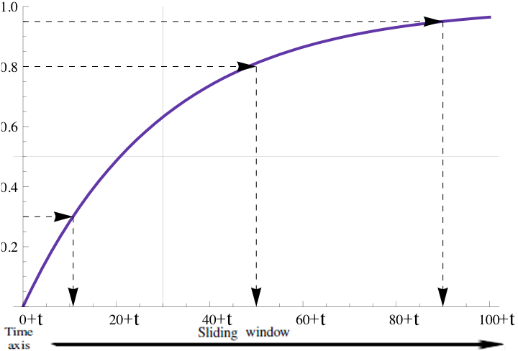
Exponential Random Picking Stochastic Gradient Descent
The random selection is based on an exponential distribution which selects values closer to more current time points, with higher probability.
This idea was nurtured by the fact that traders know that the present stock price encodes more recent information than do historical prices. They do not want to forget the past entirely but they aim to place emphasis on the present as the balances may have changed concerning old statistics.
It is easily understood that prior time points have less chance of being selected than more recent ones.

Slide 51
Experimental Results
Plain Stochastic Gradient Descent.
From here on we will refer to it as plainSGD
Stochastic Gradient Descent with random sample picking
From here on we will refer to it as approxSGD
Stochastic Gradient Descent with random sample picking and warm start
From here on we will refer to it as approxWarmSGD
The way in which the experiments were conducted was by contrasting the three versions of Stochastic Gradient Descent.

Slide 52
FOREX Data Sets
The primary dataset was obtained by Capital K Partners. It is composed of 28 different currency pairs with ticks aggregated every 100ms. There are in total 80 days of data, starting from 01/05/2012 until 09/08/2012. Every pair consists of 42 features (such as the best bid/ask price, best bid/ask volume, mid prices, bid/ask range, bid/ask slope etc.).
For the sake of simplicity they only used the bid/ask prices.
The procedure they followed was to use all the pairs associated with EUR currency (i.e. EURCAD, EURAUD, EURGBP) to predict the price of EURUSD pair. In other words they formed the training matrix X by using the prices from all the currency pairs and the target array y, by using the prices from the EURUSD pair.

Slide 53
FOREX Data Sets
The secondary dataset on Forex data was obtained by a hedge fund from Singapore. Its far more simplistic and it contains ticks aggregated every 5 minutes for a time period of around three months. Its only logical that 5 minutes is a large interval in which they omitted a lot of information and they did not expect the consistent results generated by the first.
The problem is that they could not predict both bid and ask prices simultaneously as they derive from different attributes. There are two separate instances of the algorithm running in parallel: one associated with the bid price and one with the ask price. In this way they combine the predictions and create a buying/selling signal for their trading system.

Slide 54
Individual Household Electric Power Consumption Data Set
This dataset contains measurements of electric power consumption in one household with a one-minute sampling rate over a period of almost 4 years. Different electrical quantities and some sub-metering values are available. This dataset consist of roughly 2,070,000 values for 4 years (16/12/2006 - 26/11/2010).

Slide 55
Individual Household Electric Power Consumption Data Set
1. Date: Date in format dd/mm/yyyy.
2. Time: time in format hh:mm:ss.
3. Global Active Power: Household global minute-averaged active power (in kilowatt).
4. Global Reactive Power: Household global minute-averaged reactive power (in kilowatt).
5. Voltage: Minute-averaged voltage (in volt).
6. Global Intensity: household global minute-averaged current intensity (in ampere).
7. Sub Metering 1: Energy sub-metering No. 1 (in watt-hour of active energy). It corresponds to the kitchen, containing mainly a dishwasher, an oven and a microwave (hot plates are not electric but gas powered).
8. Sub Metering 2: Energy sub-metering No. 2 (in watt-hour of active energy). It corresponds to the laundry room, containing a washing-machine, a tumble-drier, a refrigerator and a light.
9. Sub Metering 3: Energy sub-metering No. 3 (in watt-hour of active energy). It corresponds to an electric water-heater and an air-conditioner.

Slide 56
Individual Household Electric Power Consumption Data Set
The reason they used a dataset so unrelated to the other two, which have an obvious financial similarity, was to cross check the predictive accuracy of their algorithm and show that this work can be more than just for financial analysis.

Slide 57
Error Reporting
Absolute Error
Relative Error
The absolute error in a measured quantity is the uncertainty in the quantity and has the same units as the quantity itself.
For example if you predict the price of a stock to be 1.3223$ ± 0.00002$, then 0.00002$ is an absolute error.
The relative error (also called the fractional error) is obtained by dividing the absolute error in the quantity by the quantity itself.
relative error = absolute error/value of the thing measured
RE = Δx/x

Slide 58
Mean Squared Error (MSE)
The mean squared error is perhaps the most important of the characterizations for an estimator. It captures the error that the estimator makes.
In statistics, the mean squared error (MSE) of an estimator is one of many ways to quantify the difference between values implied by an estimator and the true values of the quantity being estimated.
ŷ_{i} is the predicted value of the i-th sample and y_{i} is the corresponding true value, then the mean squared error (MSE) is estimated over n_{samples}

Slide 59
Explained Variance Score
Explained variation measures the proportion to which a mathematical model accounts for the variation (dispersion) of a given data set.
ŷ is the estimated target output and y is the corresponding (correct) target output

Slide 60
R² Score, the Coefficient of Determination
The coefficient of determination, denoted R2, is used in the context of statistical models whose main purpose is the prediction of future outcomes on the basis of other related information.
R2 is most often seen as a number between 0.0 and 1.0 and is used to describe how well a regression line fits a set of data.
It provides a measure of how well future outcomes are likely to be predicted by the model
ŷ_{i} is the predicted value of the i-th sample and y_{i} is the corresponding true value, then the score R² is estimated over n_{samples}

Slide 61
Parameter Tuning
Learning Rate
any real value thus it is not feasible to test every combination
Regularization Term
L1 norm
L2 norm
Loss Function
Sliding Window
Approximate Time Points
They had 5 distinct parameters in the algorithm. In order to determine the appropriate value for every attribute and for every dataset, they isolated them and through permutations, they modied only the parameter under consideration to attain the optimal solution.

Slide 62
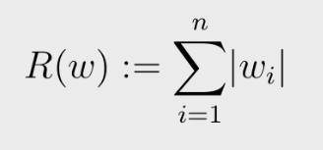
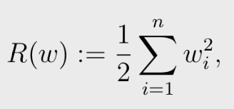
Parameter Tuning
Regularization Term
By far the most popular loss functions used for regression problems are based on Least Squares estimation. They are alternately referred to as the minimizer of the residual sum of squared errors (RSS). The two most popular least squares choices for the regularization term R are:
L1 norm:
L2 norm:

Slide 63
Parameter Tuning
Loss Function
There are several loss types of loss functions:
Hinge: (soft-margin) Linear Support Vector Machine
Modified Huber: Smoothed hinge loss
Log: Logistic Regression
Squared Loss: Ordinary least squares
Huber: Huber loss for robust regression
Epsilon Insensitive: Linear Support Vector Regression
The Last 3, Squared Loss, Huber, and Epsilon Insensitive, were used in this experiment.

Slide 64
Parameter Tuning
Sliding Window
If you train more data then the results would be more accurate. Nevertheless, while the sliding window increases, time complexity increases as well, which is something they did not want as time execution is always important. Moreover, an optimal sliding window for all the datasets could not exist. All in all they needed a value small enough, in order not to increase the time SGD needs to converge, as well as a value which will minimize the error based on each particular dataset.
SW_{capital K Forex Dataset} = 72
SW_{singapore Forex Dataset} = 100
SW_{Electrical Consumption Dataset} = 155

Slide 65
Parameter Tuning
Approximation Time Points
This is probably the most interesting feature of the approximation algorithm. If the sliding window, on which plainSGD uses all the samples to train the model is SW, then let the size of the dataset used from approxSGD and approxWarmSGD be approxSW.
Again neither case could they define a global standard for how many random samples of to what extent in the normal sliding window they should use. They then set Size_{approxSW} = Size_{SW} – 1 produce a prediction with the smallest relative and mean squared error. They contrasted this approach with setting Size_{approxSW} = Size_{SW} /2, in order to see how the algorithm behaves when they decrease the number of time points examined.

Slide 66
Results

Slide 67
Results
We can see that the method (approxWarmSGD) is better than the other two in all four metrics. The remarkable thing though is that even though they decreased the number of time points examined by half, there is almost no loss in the accuracy of the results.

Slide 68
Results

Slide 69
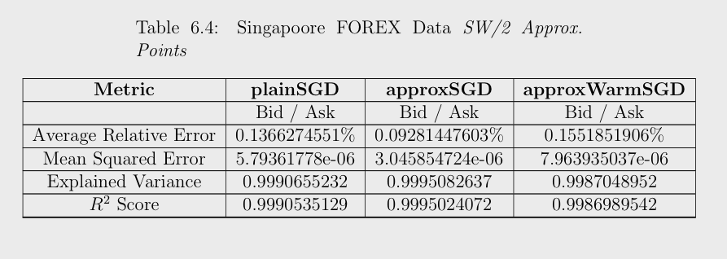
Results
As we can see for this particular dataset approxSGD without the warm start performs better. The reason is probably that the values are infrequent (ticks every 5 minutes).

Slide 70
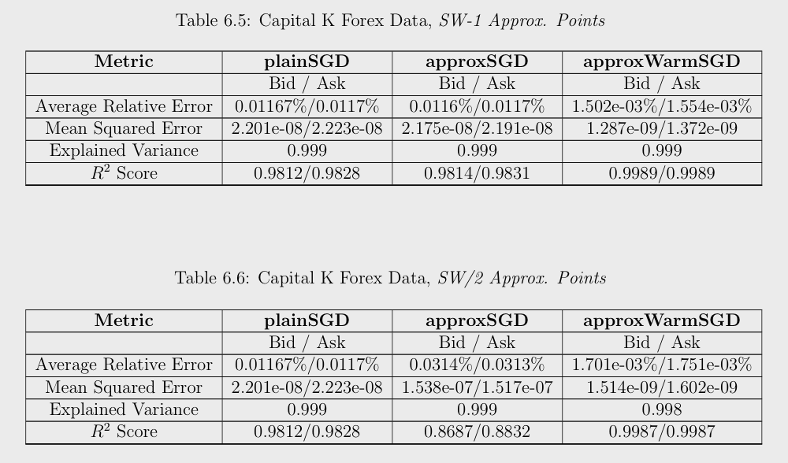
Results
It is palpable that approxWarmSGD is superior in all metrics. The results even if they use SW/2 time points are approximately the same and the relative error is remarkably low (0.0015%).

Slide 71
Spread Based Trading
If bid_prediction_{t+1} > ask_{t} then buy at time t and sell at t + 1 If the bid price at time point t + 1 is larger than the ask price at time t, it means that they will get a positive profit if they buy something that will be sold later for a higher price, than the price they bought it.
If ask_prediction_{t+1} < bid_{t} then sell at time t (supposing you have 1 unit available) and rebuy it at t + 1 to make things even. If the ask price at time point t + 1 is smaller than the bid price at time t, it means that if they sell something now and rebuy it later they will gain a profit by exploiting this spread.
In contrast to the above, the approach they followed was again a very basic one, aimed at showing that if they rely on the learning algorithm they can make a constant positive profit even if their trading technique does not revolve around macroeconomic theories and models.
This strategy relies mostly on the spread of the bid and ask prices for consecutive time points.

Slide 72
Results
Capital K FOREX Data Set
The following table shows the trading results for every day and the total profit in the end for Spread Based Trading. The first column (goldenMethodProt), is the maximum profit they could gain if they predicted the exact value for the next time point. They “hacked” the trading algorithm by reading the actual price for the next time point and deciding to buy, sell or do nothing. In this way they could never make a wrong decision and maximize the profit.

Slide 73
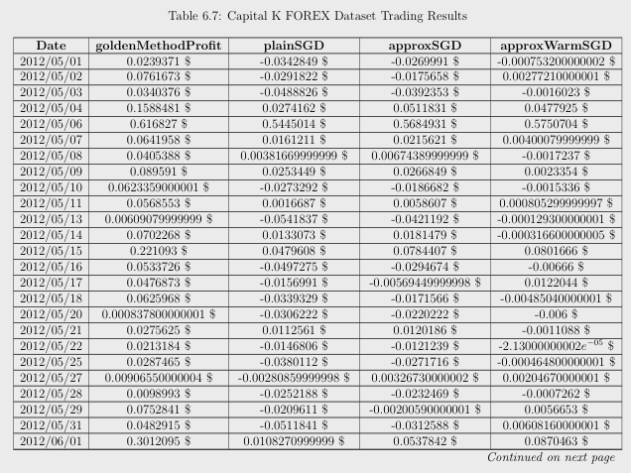

Slide 74
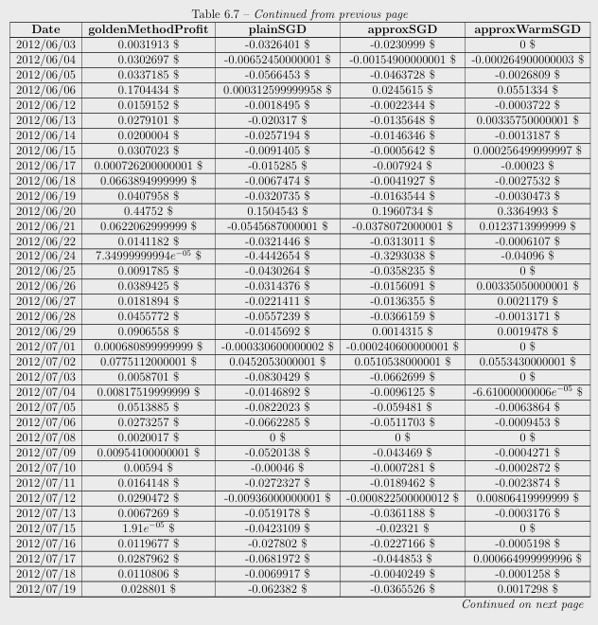

Slide 75
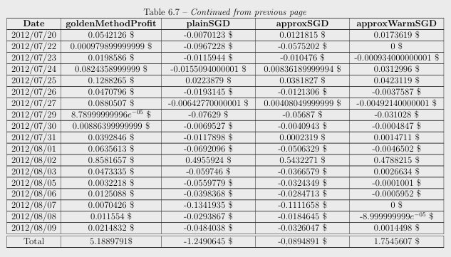
Results

Slide 76
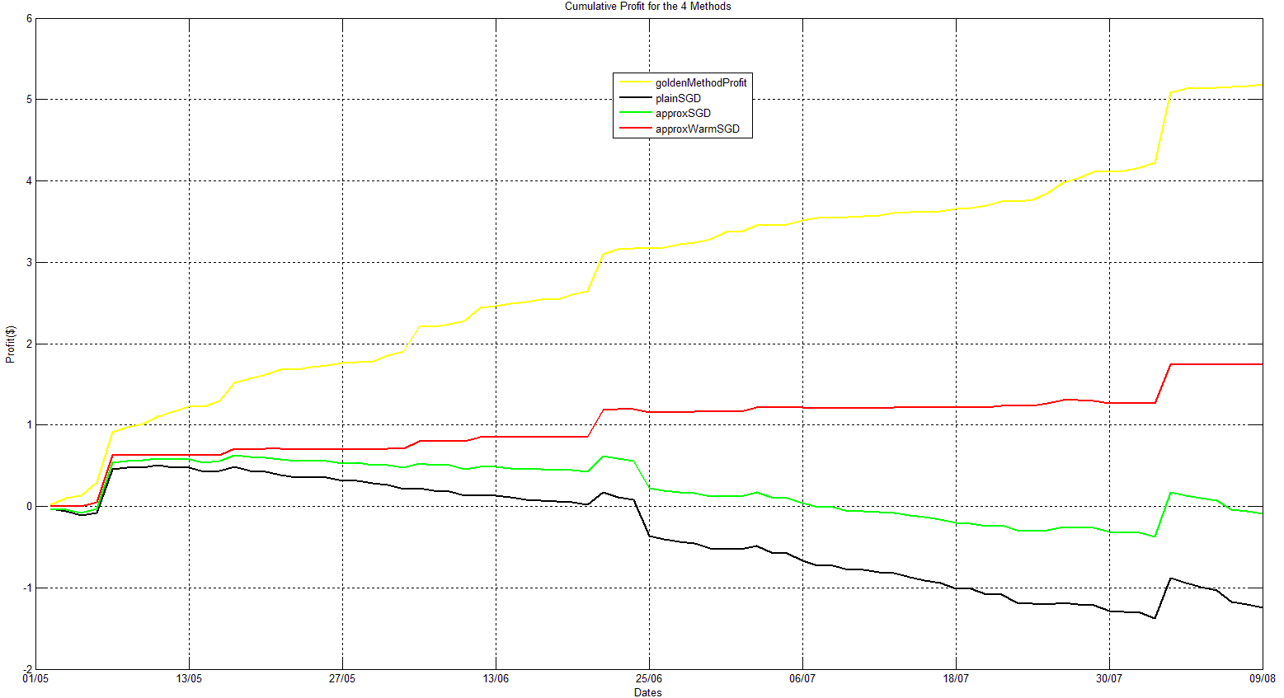
Results
PROFIT
DATES

Slide 77
Results
As we see approxWarmSGD is the only method that in the end has a positive profit. The astonishing thing is that even in the days when you “bleed” through loss the algorithm somehow manages to minimize it and restrain it at about 1/10 of the loss of the other two methods.

Slide 78
Results
The Singapore FOREX Dataset the results were not so encouraging…

Slide 79
Conclusion
Although the authors of the paper have a great general concept of what it is that they want to do and how it could be accomplished, they were only able to really show that it is a possibility to use, virtually streaming, online machine learning methods to predict future data. Their methods were continuously hand tailored to show that they could be succesful, but the time and work put into tailoring the process did not outshine methods that deal primarily with extensive data mining.

Slide 80
References
Shasha, Dennis. Online Machine Learning Algorithms For Currency Exchange Prediction. NYU CS Technical Report. 2013.

